Slide 1









Synchro
Improving The Way We Work
19 May 2014

Slide 2
Legal Disclaimer
ASU30
ASU30 and ATUU30 are acronyms for Adult Smoker Under 30 and Adult Tobacco User Under 30. The term ‘adult’ is defined by local law, but shall in no circumstance refer to any person under the age of 18. Likewise, consistent with BAT’s International Marketing Standards, terms such as ‘consumer’, ‘target consumer’, ‘smoker’, or ‘target audience’ refer only to smokers whom are adults.
LOCAL LEGISLATION / REGULATIONS
The material contained in this document may present executions and themes that are not legally permissible or acceptable in some markets. Likewise, because tobacco regulation and the company’s own views on socially responsible marketing change over time, previously approved activities may no longer be permissible. Therefore, you must obtain local legal and CORA approval before proceeding with any activity in your market.
COPYRIGHT AND CONFIDENTIALITY
© British-American Tobacco (Holdings) Limited 2014. All rights reserved. No part of this document may be reproduced in any form or any means without the prior written consent of British-American Tobacco (Holdings) Limited (˝BAT˝).
This document is proprietary to BAT and is provided to employees of the BAT Group and certain trusted contractors working for a member of the BAT Group. It is disclosed solely for use by employees in the course of their employment or by contractors for the purpose of facilitating the provision of services by that contractor to the employing BAT company and for no other purposes. Unauthorised possession or use of this material or disclosure of the proprietary information without the prior written consent of BAT may result in legal action.
THIRD PARTY TRADEMARKS
“Trademarks, logo designs and/or brand names featured in this material and not owned by British American Tobacco PLC (or one of its group companies) are owned by the relevant proprietor of the particular trademark and/or brand name in question, and are referred to in this document for informational and/or illustrative purposes only.”
2

Slide 3
Agenda
Case for Change!
Enabling
Flexible
Rollout
1
SYNCHRO Aims & Benefits
2
SYNCHRO End-to-End Process
3
Waiver Process
4
SYNCHRO Next steps

Slide 4
Agenda
Case for Change!
Enabling
Flexible
Rollout
1
SYNCHRO Aims & Benefits
2
SYNCHRO End-to-End Process
3
Waiver Process
4
SYNCHRO Next steps

Slide 5
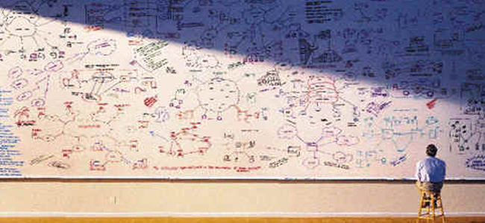
The Research process today
Complex?
Compliant?
MRTS!
Holistic?
Integrated?
Notes:
Today BAT completes about 1,500 Market Research projects each year.
The research process today can be complex and disjointed. Roles and responsibilities are not always clear. It is not fully integrated into our ways of working and other BAT processes.
We face challenges in terms of document control and retrieval…Which was the latest Questionnaire? Where is the final research report? Was the brief approved by Legal?
We have complicated reporting requirements through MRTS.

Slide 6
What is Synchro?
Q:
What is SYNCHRO?
A:
SYNCHRO is an end to end online research project
planning & management system
Impact
SYNCHRO is designed to transform
the way we manage our research projects
Notes:
SYNCHRO has been created to manage the end to end research project planning and management.

Slide 7

Synchro – Change Management
Change Management
Notes:
This involves a change in how we work

Slide 8






Synchro – Stakeholder Groups
Marketing Research Project
Marketing / Product
SPI
Research Agency
Legal
Procurement
Comms Agency
SPIM
EM Super-User
Agency Super-User
Notes:
Different Stakeholders will use SYNCHRO.
SPI and the Agency have now all been trained. In each End Market there are SPI and Agency Super Users who will be your first port of call if you have a process query.
This session is to ensure Project Owners (Marketing/Product/Trade); Legal; Procurement and Comms Agency understand how SYNCHRO will support the Research Process and their specific roles within it.

Slide 9
Agenda
Case for Change!
Enabling
Flexible
Rollout
1
SYNCHRO Aims & Benefits
2
SYNCHRO End-to-End Process
3
Waiver Process
4
Next steps

Slide 10
Eight step Process to Successful Research
SYNCHRO End to End Process:
1.
2.
3.
4.
5.
6.
7.
8.
Project Initiation
Project Briefing
Agency Proposal
Project Award
Project Specs (Final)
Project Execution
Project Reporting & Upload
Project Evaluation
SYNCHRO – Project Design
Project Based on 6 Documented Steps (as today)
All Project Planning Documents (1, 2,3 & 5) Build upon One Another (Sequential & Modular)
No Information Duplicated
Comprehensive Specification
One Version
One Location
Applicable to Branded & Non-Branded Projects
Notes:
The research process in SYNCHRO is not really any different to what we do today. There are 8 steps of which 6 happen directly in SYNCHRO. We will see who is responsible at each stage in a moment.
Project Initiation: Intention to do a project. Limited detail required. Usually done at the planning stage.
Project Brief: Enough detail so that the Research Agency can write a proposal. The brief can be sent to up to 3 agencies in a competitive tender process if required.
Agency Proposal: including methodologies and costing.
Project Award: Ultimately done by the Budget Owner outside of SYNCHRO.
Project Specs: the key documents to do the research, eg Screener, Questionnaires etc
Project Execution will of course happen outside of SYNCHRO
Project Reporting & Upload: loaded into SYNCHRO for review. Agency upload final Research Reports.
Project Evaluation: BAT can rate the agency. The agency can also provide comments.

Slide 11

Synchro – Starting a Project
Before Starting A Project In SynchrO
Discuss and Agree Intent with ALL key Stakeholders
DIALOGUE
Check what information currently exists, look on IRIS
11
Notes:
SYNCHRO is a tool which enables the research process. It should not stop stakeholders speaking to each other!
SPI needs to discuss with the Project Owner the need for research and should check what already exists. Obviously only if a research project is required should the project be initiated. SPI is responsible for creating this simple, but important document in SYNCHRO.

Slide 12
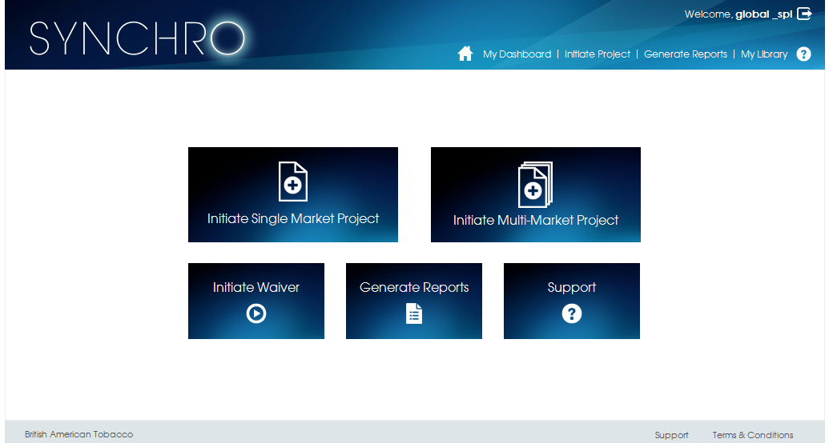
Initiate a Project
12
Notes:
This is the homepage of SYNCHRO
Key Features:
Initiate a Single Market Project: Most projects will be of this type and this will take you to the PIT screen.
Initiate a Multi-Market Project: Will be required above market only.
Initiate a Waiver: More on Waivers later, but this is where you do not want to do a specific research.
Generate Reports: A set of standardised reports + the functionality to create your own reports
Support: Where to get help (Helpdesk, Video Tutorial)
My Dashboard: Can review/find all your projects in easy to use format. More on this later in this presentation.
My Library: Where you can save specific documents (eg a completed brief that you may want to re-use for future projects).
So you would click on Initiate a Single Market Project to go to the PIT creation screen.

Slide 13
Synchro - Project Flow
1
2
3&4
5
6
7
8
PIT
PIB
Proposal
& Award
Project
Specs
Fieldwork
Report
Project
Evaluation
SPI
PO
A
A
A
SPI
Product + SP&I Review Prior to Publication
SPI
SPI
SPI
SPI
A
Legal approval Off-line
Review & Input into Brief
PO
PO
PO
Legal approval Off-line
Stakeholders (FYI only within SYNCHRO)
SPI
A
SPI
PO
SPI (if different to PIT creator)
Legal
Procurement
Product
Comms Agency
Legal approval Off-line
Verify Product Specs/ Design
A
Legend
Write & Sign-off
Write
Review
Review & sign-off
SynchrO
PO = Project Owner / A = Agency
Notes:
This slide summarises where different stakeholders are involved in the end-to-end research process.
The following slides go through this on a step-by-step process so you do not need to dwell on this one for too long.

Slide 14
Project Initiation (PIT)
1
2
3&4
5
6
7
8
PIT
PIB
Proposal
& Award
Project
Specs
Fieldwork
Report
Project
Evaluation
SPI
Stakeholders (FYI only within SYNCHRO)
PO
SPI (if different to PIT creator)
Legend
Write & Sign-off
Write
Review
Review & sign-off
PO = Project Owner / A = Agency
Notes:
Step 1 is the Project Initiation Template (PIT). It is the starting point for a project.

Slide 15



Synchro – PIT
PIT ….Similar content to MRTS but not MRTS!
Work steps
Project name, description, methodology, brand, End Market etc
Estimated cost
Estimated timeframe
Project Owner and SP&I Stakeholder
SP&I to Complete PIT
Time to complete
Est. 10 minutes
Goal
Project Created
15
Notes:
Details on the PIT:
SPI complete the PIT in SYNCHRO. Very simple to do.
At the end of the process SPI send an email from SYNCHRO to the Project Owner (who is the budget owner) and to the SPI Lead (if the PIT creator is not already the SPI lead)
If a Project Owner does not yet have access to SYNCHRO the PIT initiator can use the “Wish You Were Here” functionality to send an email to the Project Owner with a link to Prism where they can request Access. Once the Project Owner gets access his/her name will automatically be assigned to this project.
The Project Owner can find their projects in SYNCHRO using “My Dashboard” or by clicking the link on the PIT email which will take them directly to the specific project. (See next slide for the Dashboard)

Slide 16
Project Brief (PIB)
1
2
3&4
5
6
7
8
PIT
PIB
Proposal
& Award
Project
Specs
Fieldwork
Report
Project
Evaluation
SPI
PO
SPI
Legal approval Off-line
The PIT process is simplified for sure. The fact that there's no duplication in the PIB makes it even better!
Stakeholders (FYI only within SYNCHRO)
PO
SPI (if different to PIT creator)
Legal
Procurement
Product
Comms Agency
BAT Super-User
During Deep-Dive Training
Legend
Write & Sign-off
Write
Review
Review & sign-off
PO = Project Owner / A = Agency
Notes:
Project Initiation Brief (PIB). This is a joint responsibility of the Project Owner and SPI. Other stakeholders will be notified at this point.
More details on the next slide

Slide 17


Synchro – Pib
PIT info automatically populated,
plus ….
Work steps
Both Project Owner and SPI Complete PIB
PIB Approved by SPI for Sending to Agency(s)
Project Owner (or delegate) inputs:
Business Question
Research Objectives
Actions Standards
Stimulus Material and Availability
(Product Specification)
Time to complete
SPI inputs:
Methodology Approach & Research Design
Timeframe updated
Reporting Requirements
Agency selection (max 3)
Stakeholders: Legal, Procurement, Product, Comms Agency
Est. 60 minutes
Goal
Fit for Purpose Brief sent to Agency(s)
17
Notes:
The PIB:
You do not need to re-key any of the data from the PIT.
The Project Owner needs to complete four sections of the PIB (plus Product Specification for Product Research).
It is possible to load attachments if required to each section. SPI can help with this if required and ultimately can edit these sections to ensure that the Brief is fit for purpose.
You can select up to three agencies for a competitive tender process. If the agency is not a user on SYNCHRO you can still select them and you would send the brief to them via PDF/email.
More on Stakeholders and Legal Sign-off on the next slide.

Slide 18

Stakeholders and Legal Sign-off (PIB)
Legal
Mandatory for SPI to identify a Legal stakeholder
Legal can access SYNCHRO to see projects
Legal cannot approve project in SYNCHRO
Legal approval must be obtained offline (eg via email)
SPI can attach this email to the PIB in ‘Other comments’ section
SPI must state in SYNCHO that Legal approval has been given and state the name of the Legal person
This process has been approved by Global Legal.
Procurement
Optional for SPI to identify a Procurement Stakeholder
Will depend whether Procurement services are required
Procurement have read-only access to assigned projects
Comms Agency
Optional for SPI to identify a Comms Agency Stakeholder
Comms Agency will have read-only access to assigned projects
Will be able to check Stimulus Requirements & timings
Product
Mandatory for SPI to identify a Product Stakeholder for all Product Tests only
Product Stakeholders will have read-only access to assigned projects, However, if they are the Project Owner, they will also have edit rights
Notes:
Global Legal have requested and approved the SYNCHRO Legal Approval process.

Slide 19
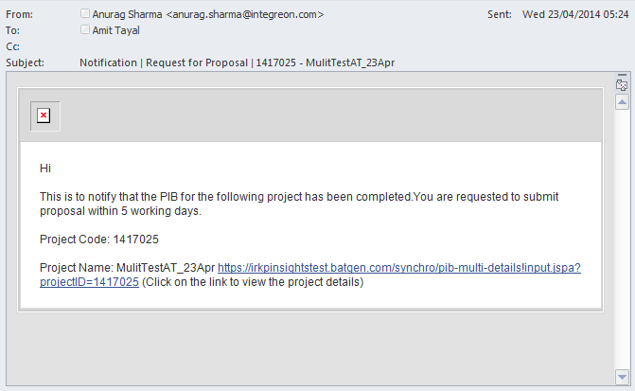
Agency is asked to Bid for a Project
BAT
Agency
Notes:
When SPI is happy that the Brief is complete an email will be generated by SYNCHRO which is sent to each Agency(s) to request a proposal.
The standard SYNCHRO email text can be edited prior to sending if required.

Slide 20
Agency Proposal & Award
1
2
3&4
5
6
7
8
PIT
PIB
Proposal
& Award
Project
Specs
Fieldwork
Report
Project
Evaluation
SPI
PO
A
SPI
SPI
Legal approval Off-line
PO
Stakeholders (FYI only within SYNCHRO)
PO
SPI (if different to PIT creator)
Legal
Procurement
Product
Comms Agency
Legend
Write & Sign-off
Write
Review
Review & sign-off
PO = Project Owner / A = Agency
Notes:
Proposal & Award:
The Agency(s) will complete the proposal and load onto SYNCHRO.
SPI can request changes if required before passing the final Proposal to the Project Owner.
Ultimately the Project Owner (the Budget Holder) will award the project.
More details on the following charts.

Slide 21
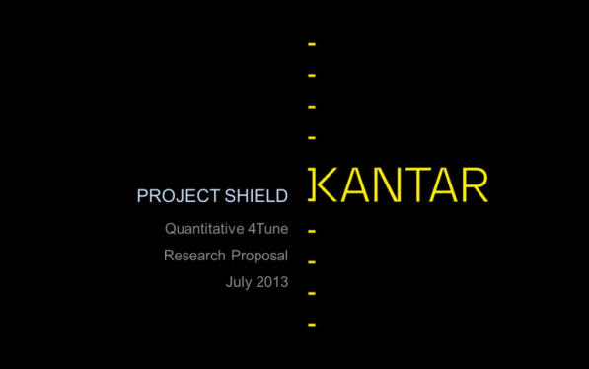
Agency Proposal
Research Agency(s) can prepare a proposal in any format e.g. ppt
Critical information must be uploaded to the SYNCHRO tool… and the full proposal + cost template attached.
Agencies can change the PIB CONTENT. This will be flagged to PO/SPI who will need to authorise any changes
Agencies will only be able to see their proposal
If non-key Agencies are asked for proposals, the data must be uploaded by the responsible SPI manager
Overtime, it is hoped that the need for Agencies to produce lengthy/complex proposals will diminish
21
Notes:
SPI will review the Agency Proposal(s) first and can ask for changes to be made.
SPI will then send in SYNCHRO the final Proposal(s) to the Project Owner (who is the ultimate Budget Holder for the project).

Slide 22
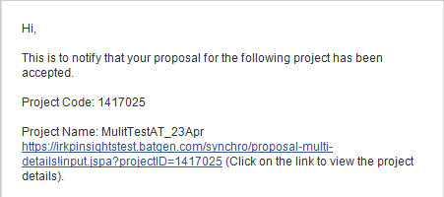
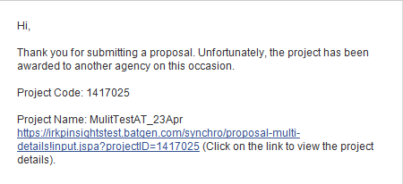
Award – Agency notified by email
Project Owner (Budget Holder) Awards Project
Agency Notified by Email
Project Owner must also raise Purchase Order (outside of SYNCHRO)
Notes:
The Project Owner will “award” the project in SYNCHRO.
SYNCHRO will automatically send an email to the successful Agency and also to any Agency(s) not awarded the project.
It is recommended that, in addition, SPI should provide feedback to the unsuccessful Agency(s).
Transactionally the actual award happens outside of SYNCHRO. The Project Owner must raise a Purchase Order (as per today). There is not direct link between SYNCHRO and SAP. This process step must be done outside of SYNCHRO.
SYNCHRO does not replace the need to talk with our Agency partners.

Slide 23
Project Specs
1
2
3&4
5
6
7
8
PIT
PIB
Proposal
& Award
Project
Specs
Fieldwork
Report
Project
Evaluation
SPI
PO
A
A
SPI
SPI
SPI
Legal approval Off-line
PO
PO
Stakeholders (FYI only within SYNCHRO)
SPI
PO
SPI (if different to PIT creator)
Legal
Procurement
Product
Comms Agency
Legal approval Off-line
Legend
Write & Sign-off
Write
Review
Review & sign-off
PO = Project Owner / A = Agency
Notes:
Project Specs:
Project specs are created by the Agency and loaded onto SYNCHRO.
SPI is responsible for agreeing these and confirming this with the Project Owner. SPI is also responsible for gaining Legal Approval.
More detail on the next slide.

Slide 24
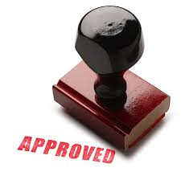

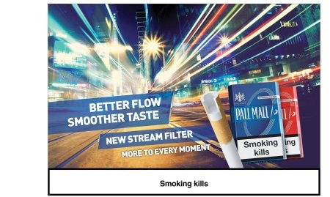
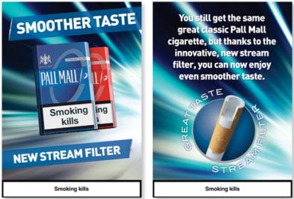




Project specs
The Project Specs are created once an Agency is awarded the project
Projects Specs are a formal record of the final agreed parameters that define the project
This includes the materials/documentation necessary to execute the project including:
Stimuli e.g. Pack Design, Comms., etc.
Screener and Respondent Contract
Questionnaire and/or Discussion Guide
This also records that all materials/ documents have been legally approved
The Agency can change the project timing and costs with supporting rationale
24
Notes:
The Agency is responsible for loading these into SYNCHRO
SPI is responsible for getting each document approved by Legal. This must happen off-line/email. For each document SPI will need to identify in SYNCHRO the name of the Legal person who gave approval.
Each document cannot be used until the final version of it is loaded into SYNCHRO and SPI has gained Legal Approval. Please note documents can be approved individually.
If there is a project delay or other unforeseen change then the Agency can make changes to timing/costs, but will need to provide supporting rationale.

Slide 25
Fieldwork Happens OUTSIDE OF SYNCHRO
1
2
3&4
5
6
7
8
PIT
PIB
Proposal
& Award
Project
Specs
Fieldwork
Report
Project
Evaluation
SPI
PO
A
A
SPI
SPI
SPI
Legal approval Off-line
PO
PO
Stakeholders (FYI only within SYNCHRO)
SPI
A
PO
SPI (if different to PIT creator)
Legal
Procurement
Product
Comms Agency
Legal approval Off-line
Legend
Write & Sign-off
Write
Review
Review & sign-off
PO = Project Owner / A = Agency
Notes:
Fieldwork can now happen.

Slide 26
Reporting
1
2
3&4
5
6
7
8
PIT
PIB
Proposal
& Award
Project
Specs
Fieldwork
Report
Project
Evaluation
SPI
PO
A
A
A
SPI
SPI
SPI
SPI
Legal approval Off-line
PO
PO
PO
Legal approval Off-line
Stakeholders (FYI only within SYNCHRO)
SPI
A
SPI
PO
SPI (if different to PIT creator)
Legal
Procurement
Product
Comms Agency
Legal approval Off-line
A
Legend
Write & Sign-off
Write
Review
Review & sign-off
SYNCHRO
PO = Project Owner / A = Agency
Notes:
Reporting:
The Report is then produced, refined, legally approved and ultimately finalised and loaded onto SYNCHRO.
More details on the next slide.

Slide 27

Synchro – Reporting
The Agency is responsible to upload reports as per PIB
These should be submitted on Synchro by the Agency
This report(s) go to SP&I
SPI will then comment. Agency to Revise if Necessary
Presentation delivered to PO / Close Team
Legal Approval Sought and comments delivered via email (not on SYNCHRO)
Agency revise and submit final version on Synchro. All draft versions to be deleted.
Quality Control
Approval
27
Notes:
The Agency will load the draft report.
SPI can provide feedback and changes prior to it going to the Project Owner. The Project Owner can also provide feedback and changes.
Legal Approval/Comments must be gained off-line/email as per other Legal Approvals by SPI.
Final version must be loaded into SYNCHRO and all previous versions deleted.
The Final Report will also be loaded onto IRIS at this stage by SYNCHRO Admin.

Slide 28
Synchro – Integration of Digital Assets
SYNCHRO
IRIS
1. Workflow Management Tool
2. Research & Insights Library
C-PSi
PRISM
4. Repository of Product Test Data and Norms
3. SP&I Interact Platform
Notes:
SYNCHRO is one the SPI digital assets. As described previously it is the workflow management tool for research projects
IRIS (new name for RKP - Research Knowledge Portal) is the Research and Insights Library. All final research reports will be loaded here.
C-Psi. Results from Product tests will be loaded on the C-Psi database to build the repository of Test Data and Norms.
PRISM – SPI’s Interact Platform - will host much of the SYNCHRO training materials and will also be the place to request access.

Slide 29
Project Evaluation
1
2
3&4
5
6
7
8
PIT
PIB
Proposal
& Award
Project
Specs
Fieldwork
Report
Project
Evaluation
SPI
PO
A
A
A
SPI
SPI
SPI
SPI
SPI
A
Legal approval Off-line
PO
PO
PO
Legal approval Off-line
Stakeholders (FYI only within SYNCHRO)
SPI
A
SPI
PO
SPI (if different to PIT creator)
Legal
Procurement
Product
Comms Agency
Legal approval Off-line
A
Legend
Write & Sign-off
Write
Review
Review & sign-off
SynchrO
PO = Project Owner / A = Agency
Notes:
Project Evaluation:
SPI will provide an agency rating specific for each project. SPI can rate International Management, Local Management and Fieldwork Agencies. SPI can provide a score for each and some comments.
The Agency(s) also have the opportunity to provide comments.
The Evaluation in SYNCHRO is for each specific project. It can provide evidence to the overall Agency Evaluation which is done twice per annum, but it does not replace this process.

Slide 30
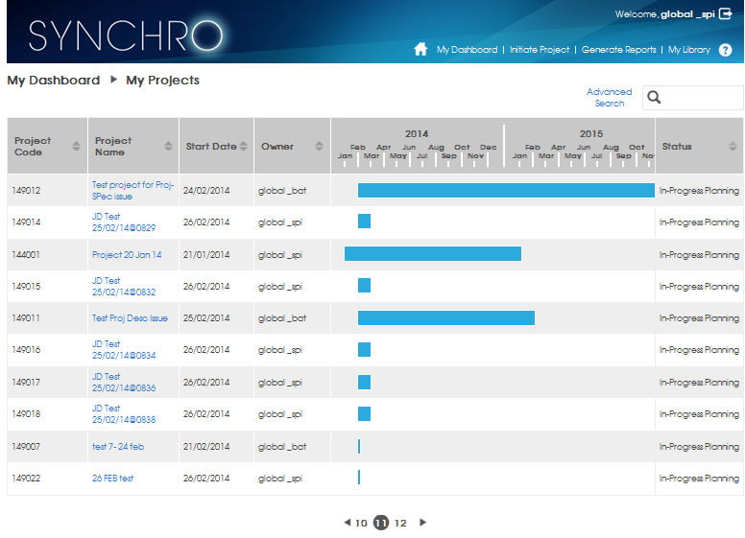
Synchro – My Dashboard
Notes:
All SYNCHRO users will have access to “My Dashboard”.
The Dashboard is a powerful tool to show all the projects assigned to you. From here you can click on a project name to go into the details.
Access will be restricted to your area of Functional and Geographical responsibility.

Slide 31

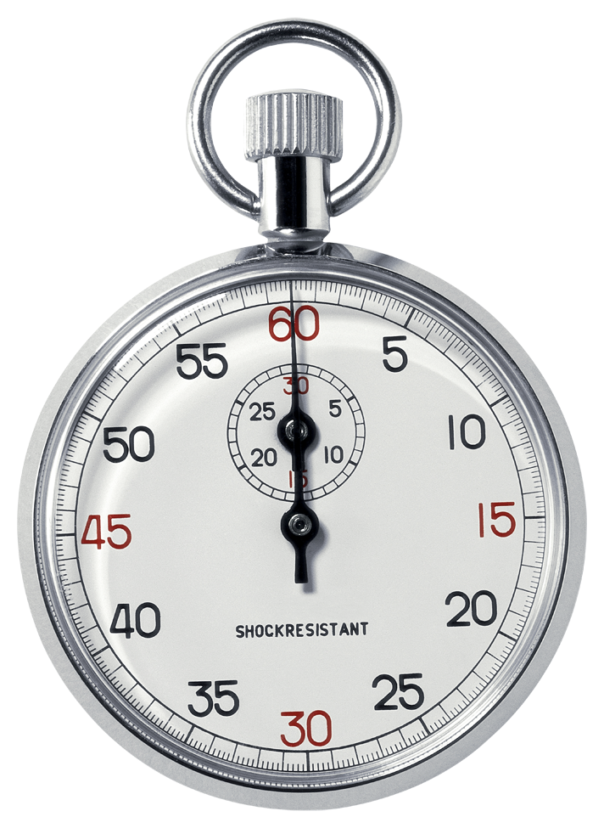
Synchro – Budget Process
Time
Cost | Origin | Pre-Plan | Budget | QPR 1 | QPR 2 | QPR 3 | Actuals
Date | - | Sept | Nov | Feb | May | Oct | 1/1/NY
Initial Estimate | PIT | ü | ü | ü | ü | ü
Latest Estimate | PIB |  | ü | ü | ü | ü
Latest Estimate (Commissioned) | PS |  | ü | ü | ü | ü | ü
Actuals | AE |  |  | ü | ü | ü | ü
Total |  | ∑ | ∑ | ∑ | ∑ | ∑ | ∑
As Process is followed, the latest cost is used for ∑

Slide 32
Synchro – Project Pathways
Single Market
Multi-Market Coordination
…Or…
Same approach as single market project but this is slightly more complex as the PO needs to by raised by budget holders who normally would reside in end-markets.
Within the system, once the PIT is created and end-markets confirm budget allocation the PIB will be tailored for each individual market as if it were a single market project.
Impact
SYNCHRO is an easily flexible platform and can accommodate
both single market and multi-market projects

Slide 33
Agenda
Case for Change!
Enabling
Flexible
Rollout
1
SYNCHRO Aims & Benefits
2
SYNCHRO End-to-End Process
3
Waiver Process
4
Next steps

Slide 34

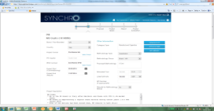
Waiver Types
❶
☒
Not in Synchro - Approval via IPSG (Recorded in Nexus)
NPI Project - Research Waiver
e.g. No 4-Tune, etc.
❷
☒
Brand Development (Not NPI) -
Research Waiver
Not in Synchro - Go ahead through Business Case Approval
❸
G4S – Research Waiver e.g. Not
to undertake study or change
benchmark/action standards
☒
Not in Synchro - Approval via GPLT (GPLT approvals to be mentioned in “Project Description” in Synchro)
❹
Other Projects – Research Waiver e.g. No GCS, CBC, etc.
On Synchro Home
Page - Approval :GHMR *
❺
All Projects – Deviation from Oracle Methodology e.g. Lower Sample Size **
On Synchro In PIB onwards
Approval: GOM * + Others
*GHMR = Global Head of Marketing Research, GOM: Global Oracle Manager
** Does not include G4S where waiver is endorsed by GPLT.
Notes:
There are five types of Waiver:
The first 3 are all waiver requests which are handled outside of SYNCHRO
Other waiver requests not to do a piece of research (type 4) can be requested on the SYNCHRO Home screen. You click on the Waiver button and follow the instructions.
Type 5: Project Deviation Waivers (Methodology Waivers – eg lower sample size) can be requested during the PIB stage. Whilst you are awaiting approval you can still go ahead and send the brief to your Agency for them to prepare a Proposal. This is to ensure that the Waiver approval does not slow down the process.

Slide 35
Agenda
Case for Change!
Enabling
Flexible
Rollout
1
SYNCHRO Aims & Benefits
2
SYNCHRO End-to-End Process
3
Waiver Process
4
Next steps

Slide 36


You will BE WELL SUPPORTED
Resources & Support
BAT Super-User
Video Tutorial
FAQs
SYNCHRO Helpdesk
assistance@batinsights.com
BAT Global SP&I
Mark Barnes & Tim Carey
36
Notes:
The End Market Super-User will be your first level of support. The Super-User will coordinate the initial list of users to be set-up in SYNCHRO. The Super-User will approve future user requests in your End Market after go-live.
The Super-User is well trained, but is also new to the system so there will be additional support:
A Video “How to …” tutorial will be created identifying the key steps in the process and will be available via the “Support” button on the SYNCHRO Home Page.
A Frequently Asked Questions (and Answers) document is available. This has been based on all the questions asked during the SPI Deep Dive training sessions.
There will be a SYNCHRO help desk which can be contacted via the “Support” button on the SYNCHRO Home Page.
If you are still stuck then you can contact Global SPI

Slide 37
Access Rights in SYNCHRO
Global
Region
Multi-Market
Multi-Market
Multi-Market
End-Market
End-Market
End-Market
Multi-Market
Region
End-Market
User Access
Only Sees
Projects Where
They Are A
Stakeholder
Within Their
Geographical
Remit
Super User Access
Sees all
Projects
Within Their
Geographical
Remit *
* Can be focussed by brand
37

Slide 38
Transition from MRTS to SYNCHRO
MRTS
* Russia = 61 Projects (2 Man Days for PIT)
2014
In SynchrO
PIT (Before 20th June)
PIB
Proposal
Project Specs
Report
Project Evaluation
Planned
Or New
(After 19th May)
*
PIT By 20th June
1,145
In SynchrO
PIT
Attach PIB (Enter Cost)
Attach Proposal,
Report
Project Evaluation
148
In-Progress
(Project Awarded
Before 19th May)
**
By 20th June
14
Completed
Total = 1,307
Projects
** Germany = 15 Projects
38
Notes:
This slide to be used with SPI teams only:
In order not to pull incorrect information into SYNCHRO (ie to keep it clean) no data will be pulled automatically from MRTS into SYNCHRO.
After 19 May all projects for 2014 should be recorded in SYNCHRO.
Planned projects will need to have PITs created and then will be managed as a normal SYNCHRO project.
Projects prior to 19 May (Completed or In Progress) will have to be created with a limited amount of critical information.
This needs to be completed by 20 June.

Slide 39
Synchro
Improving The Way We Work
19 May 2014

